Slide 1
Works
1
Literature comparison
2
IEEE EMBC one-page paper
3
Thesis Chinese and English title confirmation

Slide 2
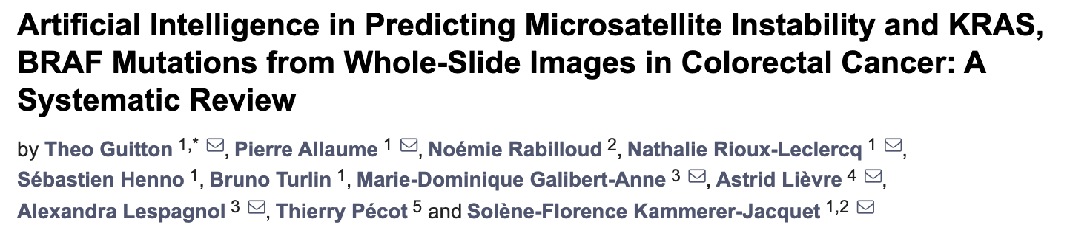
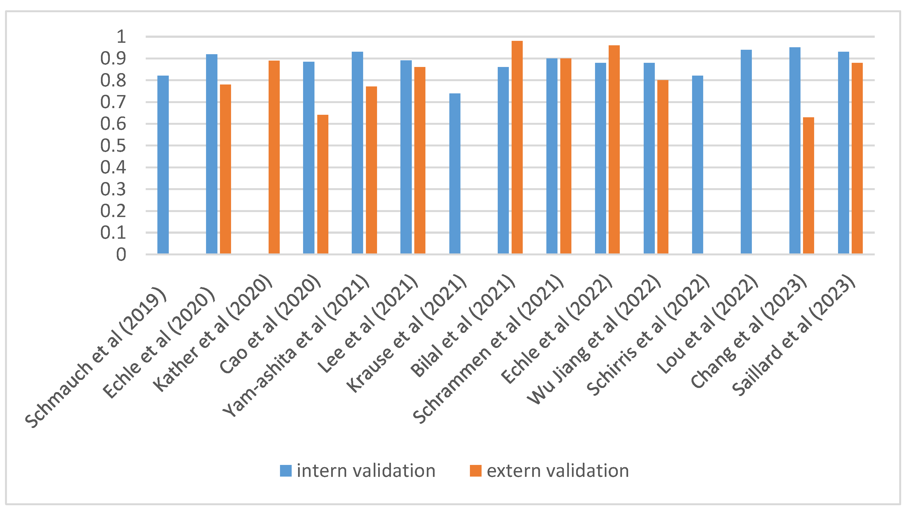
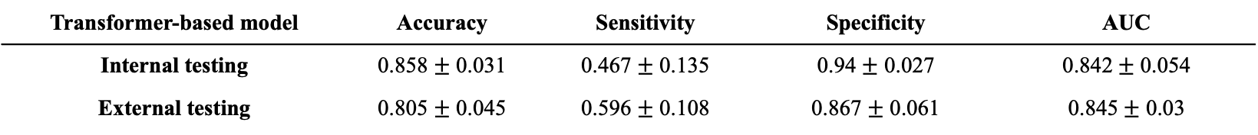
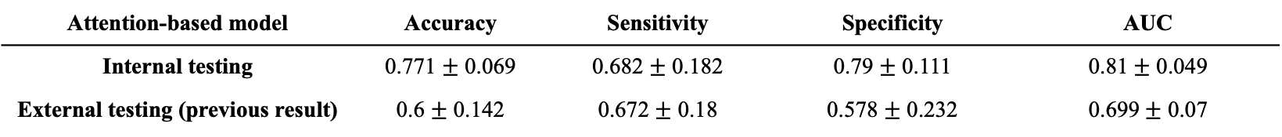
Literature comparison
MSI prediction
Attention-based model | Accuracy | Sensitivity | Specificity | AUC
Internal testing | 0.771 $±$ 0.069 | 0.682 $±$ 0.182 | 0.79 $±$ 0.111 | 0.81$±$ 0.049
External testing (previous result) | 0.6 $±$ 0.142 | 0.672 $±$ 0.18 | 0.578 $±$ 0.232 | 0.699$±$ 0.07
Transformer-based model | Accuracy | Sensitivity | Specificity | AUC
Internal testing | 0.858 $±$ 0.031 | 0.467 $±$ 0.135 | 0.94 $±$ 0.027 | 0.842$±$ 0.054
External testing | 0.805 $±$ 0.045 | 0.596 $±$ 0.108 | 0.867 $±$ 0.061 | 0.845$±$ 0.03

Slide 3
Literature comparison
MSI prediction
Enhance sensitivity
Add dropout into MLP to reduce model complexity during training in both models
Attention-based model | Accuracy | Sensitivity | Specificity | AUC
Internal testing | 0.771 $±$ 0.069 | 0.682 $±$ 0.182 | 0.79 $±$ 0.111 | 0.81$±$ 0.049
External testing (previous result) | 0.6 $±$ 0.142 | 0.672 $±$ 0.18 | 0.578 $±$ 0.232 | 0.699$±$ 0.07
Transformer-based model | Accuracy | Sensitivity | Specificity | AUC
Internal testing | 0.858 $±$ 0.031 | 0.467 $±$ 0.135 | 0.94 $±$ 0.027 | 0.842$±$ 0.054
External testing | 0.805 $±$ 0.045 | 0.596 $±$ 0.108 | 0.867 $±$ 0.061 | 0.845$±$ 0.03

Slide 4
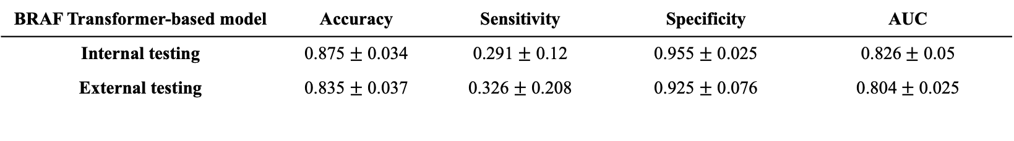
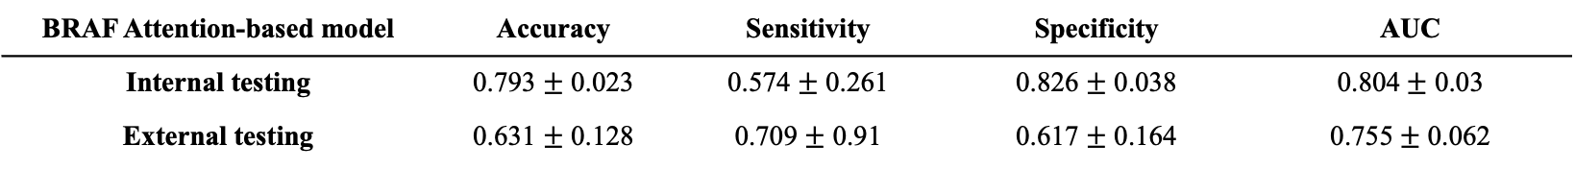
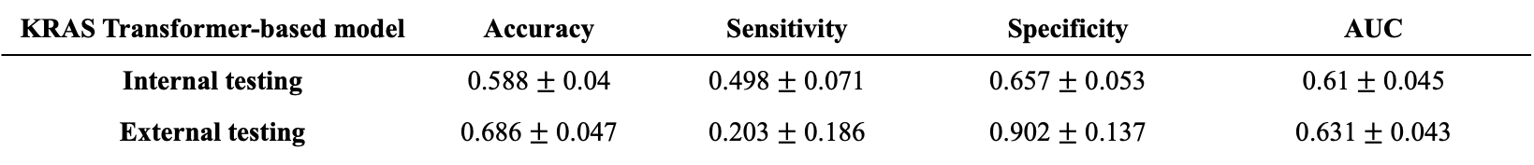
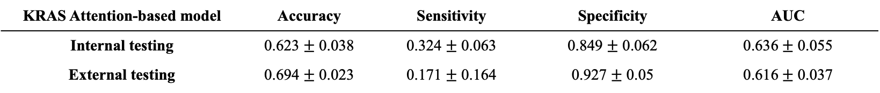
Literature comparison
BRAF and KRAS prediction
Some studies (n = 3) also explored the mutational status of KRAS and BRAF.
All studies had almost similar results when determining the KRAS mutation with an AUC of 0.6 approximately
Schrammen et al. used the most data with DACHS (n = 2448) and obtained the best result to determine the BRAF mutation with an AUC of 0.82
BRAF Attention-based model | Accuracy | Sensitivity | Specificity | AUC
Internal testing | 0.793 $±$ 0.023 | 0.574 $±$ 0.261 | 0.826 $±$ 0.038 | 0.804$±$ 0.03
External testing | 0.631 $±$ 0.128 | 0.709 $±$ 0.91 | 0.617 $±$ 0.164 | 0.755$±$ 0.062
BRAF Transformer-based model | Accuracy | Sensitivity | Specificity | AUC
Internal testing | 0.875 $±$ 0.034 | 0.291 $±$ 0.12 | 0.955 $±$ 0.025 | 0.826$±$ 0.05
External testing | 0.835 $±$ 0.037 | 0.326 $±$ 0.208 | 0.925 $±$ 0.076 | 0.804$±$ 0.025
KRAS Attention-based model | Accuracy | Sensitivity | Specificity | AUC
Internal testing | 0.623 $±$ 0.038 | 0.324 $±$ 0.063 | 0.849 $±$ 0.062 | 0.636$±$ 0.055
External testing | 0.694 $±$ 0.023 | 0.171 $±$ 0.164 | 0.927 $±$ 0.05 | 0.616$±$ 0.037
KRAS Transformer-based model | Accuracy | Sensitivity | Specificity | AUC
Internal testing | 0.588 $±$ 0.04 | 0.498 $±$ 0.071 | 0.657 $±$ 0.053 | 0.61$±$ 0.045
External testing | 0.686 $±$ 0.047 | 0.203 $±$ 0.186 | 0.902 $±$ 0.137 | 0.631$±$ 0.043

Slide 5
Thesis Chinese and English title confirmation
中文
以整合式深度學習用於結腸腺癌病理切片影像預測生物標記
以串聯式深度學習基於結腸腺癌病理切片影像預測生物標記
基於串聯式深度學習以結腸腺癌病理切片影像預測生物標記
英文
Prediction of biomarker from colon adenocarcinoma histopathological images via integrated deep learning pipeline
Prediction of biomarker from colon adenocarcinoma histopathological images via cascaded deep learning pipeline
Prediction of molecular biomarker from colon adenocarcinoma histopathological images via cascaded deep learning pipeline

Slide 6
Workflow
a. WSI image preprocessing
d. Biomarker prediction model
- attention-based model
- patch generation
- transformer-based model
- color normalization (Macenko method)
- blurry patch removal (Laplacian algorithm)
e. Model interpretability
- attention heatmap
b. Tumor detection model
- VGG19, ResNet101
- tissue type heatmap
- grad-cam
c. Feature extraction
- ResNet50 self-supervised learning pre-training (SimCLR)
- ResNet50 self-supervised learning pre-training (BYOL)

Slide 7
Future works
1
Finish training with SimCLR and BYOL feature
2
Add PCA into current pipeline

